Slide 1

Nearly Optimal Sparse Group Testing
Venkata Gandikota, Purdue University
Elena Grigorescu, Purdue University
Sidhart Jaggi, The Chinese University of Hong Kong
Samson Zhou, Purdue University
TexPoint fonts used in EMF.
Read the TexPoint manual before you delete this box.: AAAAAAAAAAA

Slide 2

Group Testing
Task: Identify a small set of defects among a larger population using tests
Test = a subset of the items
A test is positive if a defective item is included; negative otherwise
Goal: Minimize the number of tests

Slide 3

Background
Motivation: Identify WW2 draftees with syphillis
Each test is expensive, but blood may be pooled
Blood from individual can be used in multiple tests
How to identify infected individuals?

Slide 4



Adaptive Group Testing

Slide 5


Non-adaptive Group Testing (NAGT)

Slide 6

Non-adaptive Group Testing (NAGT)

Slide 7
Non-adaptive Group Testing (NAGT)
0 1 0 0 0 0 1 0 0 1 0 0 1
1 1 0 1 0 0 0 1 1 0 0 0 0
0 0 0 0 1 1 1 0 0 1 1 1 0
1 1 1 1 0 0 0 0 0 0 0 1 1
0 0 1 1 0 0 0 1 0 0 1 0 0
0 0 0 0 0 1 1 0 0 0 1 0 1
0 0 1 0 1 0 0 1 0 1 0 0 0
1 0 0 0 0 0 1 1 0 1 1 0 0

Slide 8
Non-adaptive Group Testing
0
0
0
0 1 0 0 0 0 1 0 0 1 0 0 1
0
0
1 1 0 1 0 0 0 1 1 0 0 0 0
1
1
0 0 0 0 1 1 1 0 0 1 1 1 0
1
1
0
1 1 1 1 0 0 0 0 0 0 0 1 1
1
0
0 0 1 1 0 0 0 1 0 0 1 0 0
0
1
0 0 0 0 0 1 1 0 0 0 1 0 1
1
0
0 0 1 0 1 0 0 1 0 1 0 0 0
0
1
1
1 0 0 0 0 0 1 1 0 1 1 0 0
0
0

Slide 9
“Classical” NAGT
Upper Bound: (Du, Hwang ‘00)
Explicit: (Porat, Rothschild ’08)
Lower Bound: (D’yachkov, Rykov ’82)
Noisy tests (CheraghchiHKV ’11)
Efficient Decoding (IndyKRN’10)
Graph-Constrained (CheraghchiKMS’11)
Phase-Transitions (Scarlett, Cehver’16)

Slide 10
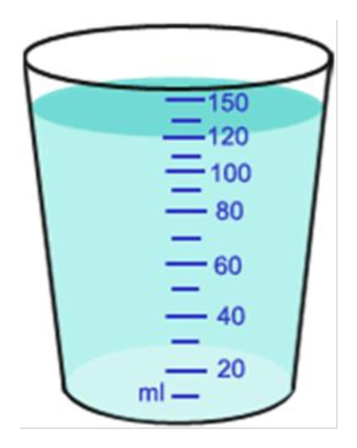


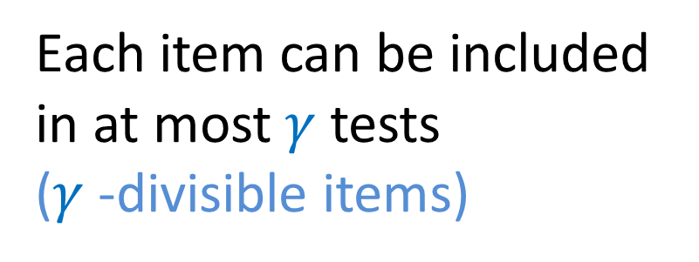
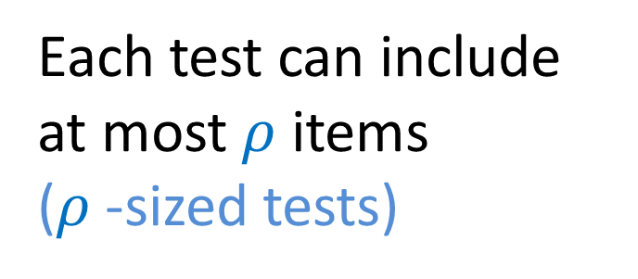
Real World Limitations
Each test can include at most $ρ$ items
($ρ$-sized tests)

Slide 11
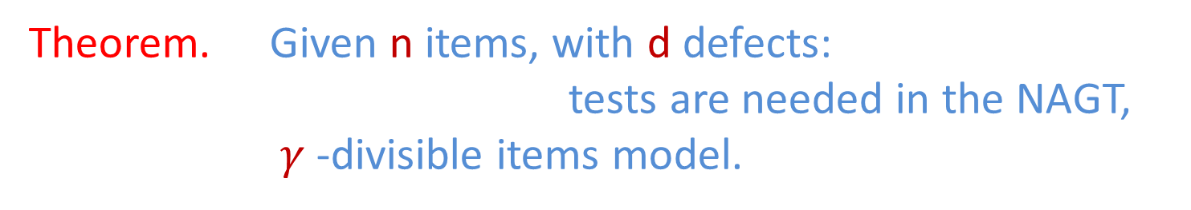

Our Results: $γ$-divisible items
Theorem. Ǝ a randomized algorithm: T =
Theorem. Ǝ a deterministic algorithm: T =

Slide 12

Our Results: $ρ$-sized tests
Theorem. Given n items, with d defects:
tests are needed in the
NAGT, ρ-sized tests model.
Theorem. Ǝ a randomized algorithm: T =
Theorem. Ǝ a deterministic algorithm: T =
Notes:
I get a weird display of symbols here too

Slide 13
Structure of Talk
Background
Achievability: Randomized Construction
Achievability: Deterministic Construction
Lower Bounds

Slide 14
Structure of Talk
Background
Achievability: Randomized Construction
Achievability: Deterministic Construction
Lower Bounds

Slide 15
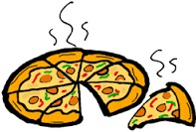
Upper Bounds: Randomized
Consider the -divisible items model

Slide 16


Upper Bounds: Randomized
Recall: Total items tested is at most
Idea: Have each test include roughly items.
Columns of test matrix M are uniformly sampled from with weight .
How to decode?

Slide 17


Decoding Algorithm Philosophy
Innocent until proven guilty
Defective until proven innocent

Slide 18

Decoding Algorithm
Algorithm: Marks item i non-defective if some test which includes i is negative
Observations:
CANNOT incorrectly identify defective items
Incorrectly marks non-defective item i if all tests which include i are positive

Slide 19


Upper Bounds: Randomized
Recall: Total number of positive tests is at most d .
Probability an item is included only in positive tests:
Union bound over all (n-d) non-defective items, so we require:

Slide 20

Upper Bounds: Randomized
Recall: Total number of positive tests is at most d .
Probability an item is included only in positive tests:
Union bound over all (n-d) non-defective items, so we require:

Slide 21
Structure of Talk
Background
Achievability: Randomized Construction
Achievability: Deterministic Construction
Lower Bounds

Slide 22
Structure of Talk
Background
Achievability: Randomized Construction
Achievability: Deterministic Construction
Lower Bounds

Slide 23
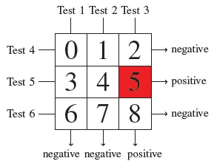
Upper Bounds: Deterministic
Intuition: Should be able to “encode” each item so that test outcomes uniquely identify defects
Idea: Use -dimensional hypergrid, represent each item by base-b representation, where
If n = 9, = 2, d = 1, the above test uniquely determines that item 5 is defective.
Notes:
Too much text on this slide…

Slide 24
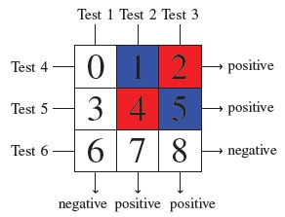

Upper Bounds: Deterministic
What if we have multiple defects?
These tests cannot distinguish whether the red items or the blue items are defective.
Notes:
Emphasize that if there is only one defect, we can uniquely determine defects

Slide 25
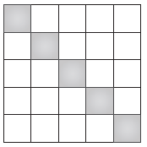
Upper Bounds: Deterministic
What if we have multiple defects?
Idea: Divide and Conquer!
Each gray box catches one defective item with high probability

Slide 26
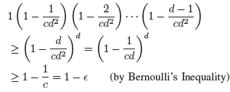
Upper Bounds: Deterministic
How many blocks are necessary?
Probability that no two defects fall into the same block:
In summary: blocks, each requiring tests, for a total of

Slide 27
Structure of Talk
Background
Achievability: Randomized Construction
Achievability: Deterministic Construction
Lower Bounds

Slide 28
Structure of Talk
Background
Achievability: Randomized Construction
Achievability: Deterministic Construction
Lower Bounds

Slide 29
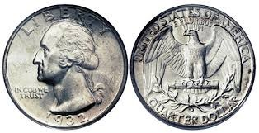
Classical NAGT Design Philosophy
0 1 0 0 0 0 1 0 0 1 0 0 1
Each test gives ̴1 bit of information

Slide 30
Lower Bounds: -divisible items
Total number of items tested is at most n
“Light” tests: each includes less than items.
“Heavy” tests: each includes at least items.

Slide 31
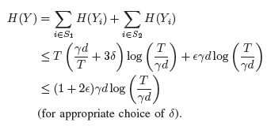
Lower Bounds: -divisible items
“Light” tests: each includes less than items.
“Heavy” tests: each includes at least items.

Slide 32
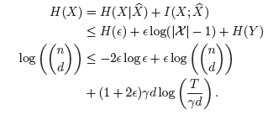
Lower Bounds: -divisible items
Data processing inequality
Fano’s inequality
Entropy over all possible combinations of d defects

Slide 33
Lower Bounds: -divisible items
Implies
Data processing inequality
Fano’s inequality
Entropy over all possible combinations of d defects

Slide 34
Structure of Talk
Background
Achievability: Randomized Construction
Achievability: Deterministic Construction
Lower Bounds

Slide 35
Structure of Talk
Background
Achievability: Randomized Construction
Achievability: Deterministic Construction
Lower Bounds
?? Results for zero-error tests and noisy tests
Notes:
Completely rework

Slide 36
Further Results
Noisy tests: Tests can give incorrect result with probability σ.
Theorem: CANNOT recover defectives with probability at least 1- ɛ for arbitrary ɛ < 1/2 and γ = o(log n).

Slide 37



Slide 38

Questions?

Slide 40
Upper Bounds: Deterministic
Intuition: Should be able to “encode” each item so that test outcomes uniquely identify defects
Idea: Use γ-dimensional hypergrid, represent each item by base-b representation, where
For test j, where j = ab + k, where and we include exactly the items whose (a+1)th coordinate is k, i.e.,
Notes:
Too much text on this slide…

Slide 41
Upper Bounds: Deterministic
Intuition: Should be able to “encode” each item so that test outcomes uniquely identify defects
If n = 9, γ = 2, d = 1, the above test uniquely determines that item 5 is defective.
Notes:
The last line doesn’t show up the math symbols

Slide 42
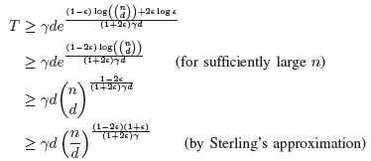
Lower Bounds: -divisible items
Notes:
Merge result with previous slide

